Slide 1
VoIP Network- cisco packet tracer
Kulkarni Atharva Gopinath

Slide 2
CONTENTS
Introduction - 3
Procedure (Steps involved) - 4
Detailed description (Stepwise configuration and description) - 6
Testing - 20

Slide 3
INTRODUCTION
3
VoIP (Voice over Internet Protocol) is a technology that allows users to make and receive phone calls over the internet, using digital signals instead of analog ones.
The network will consist of four departments: Finance, HR, Sales and ICT, each with 10 desktops and one printer. Each desktop will have an associated telephone set, connected directly to the PC. The network will also have four servers (DHCP, EMAIL, DNS, HTTP) located at the server side site, which will provide various services to the users. All servers will be shared between all users.

Slide 4
PROCEDURE
→ Steps involved in configuring the network.
→ Technologies implemented.

Slide 5
PROCEDURE
Network design.
VLANs assignment plus all access and trunk ports on switches.
Subnetting and IP addressing.
Static IP address to server room devices.
DHCP server device configurations.
6. Configure DHCP for voice.
7. Inter-VLAN routing on the routers plus IP DHCP helper addresses.
8. OSPF on the routers.
9. Configure VoIP configuration in all routers.
10. Dial peering configuration in all routers.

Slide 6
Detailed description
→ Stepwise description of the routing protocols involved.
→ Relevant Cisco IOS commands are used while implementing.

Slide 7
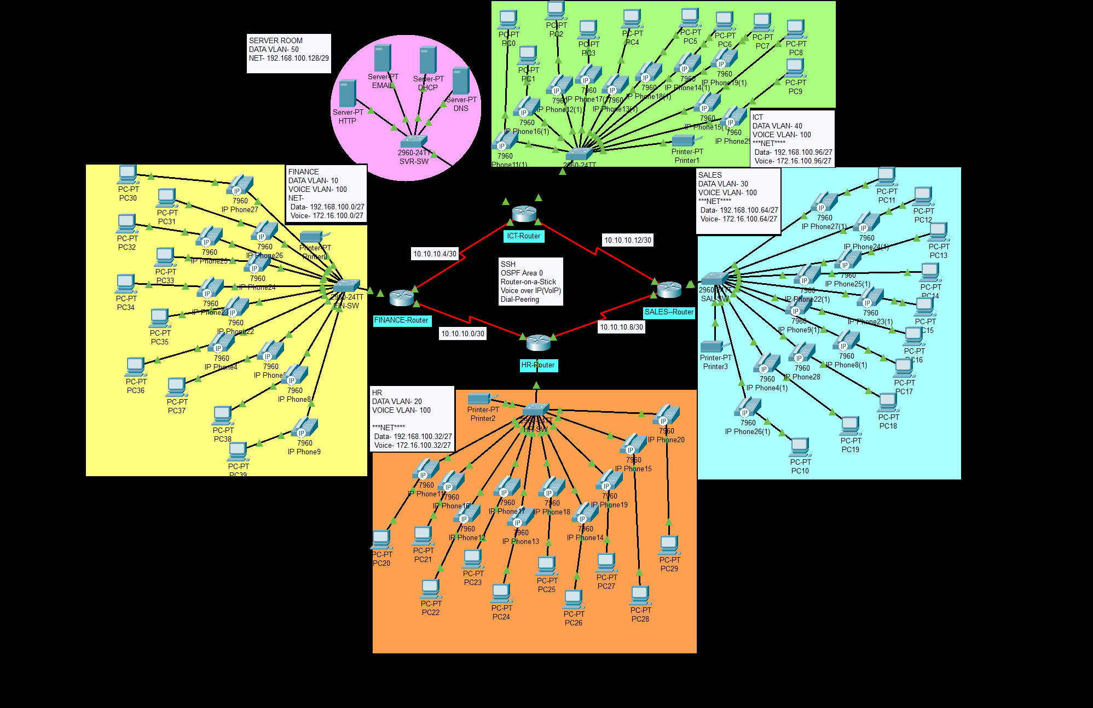
1. Network design
Four departments – Finance, HR, Sales, ICT
Every PC is connected to a telephone
Every department: 10 PCs and 1 printer
A common DNS is enabled

Slide 9





2. VLANS, Access and trunk ports on switches
FINANCE
HR
SALES
ICT
SERVER ROOM
DATA VLAN - 10
VOICE VLAN - 100
DATA VLAN - 20
VOICE VLAN - 100
DATA VLAN - 30
VOICE VLAN - 100
DATA VLAN - 40
VOICE VLAN - 100
DATA VLAN - 50

Slide 10
2. VLANS, Access and trunk ports on switches
As specified in the previous slide, the network has different VLAN IDs for data in each department but same voice VLAN ID throughout.
This is to enhance the data security and performance.
Also, the need of inter-VLAN routing for voice is nullified by doing this. The same DHCP options and Voice parameters are used throughout the voice configuration.
Switchport modes: Trunk and Access have been configured.

Slide 11
3. Subnetting and ip addressing
FINANCE
HR
SALES
ICT
SERVER ROOM
DATA IP – 192.168.100.0/27
VOICE IP – 172.16.100.0/27
DATA IP – 192.168.100.32/27
VOICE IP – 172.16.100.32/27
DATA IP – 192.168.100.64/27
VOICE IP – 172.16.100.64/27
DATA IP – 192.168.100.96/27
VOICE IP – 172.16.100.96/27
DATA IP – 192.168.100.128/29

Slide 12
3. Subnetting and ip addressing
By assigning a subnet mask of /27 to every department, we ensure that there are equally sized subnets
Some of them are reserved for future use.
This avoids network re-design and re-configuration.
A /29 mask is used for the Server Room, we ensure that we have enough space for 4 servers namely: DNS, DHCP, HTTP and EMAIL. We also reserve some of the IP addresses for future addition of servers.

Slide 13
4. Static ip address to server room devices
To ensure fixed and predictable IP addresses for easy access and management.
To enable some services, such as DNS and DHCP, to work properly.
To improve network security and performance by matching IP addresses with services and VLANs.

Slide 14
5. DHCP server device configurations
To provide dynamic IP addresses to the data devices on the network.
To set up scopes, pools, and options for each data VLAN.
To have a static IP address on the server VLAN.
To use the router as a relay agent for different VLANs.

Slide 15
6. Configure dhcp for voice
Exclude an IP address: 172.16.100.97 from the DHCP pool to avoid conflicts with the router interface that connects to the voice VLAN.
Create a DHCP pool with a name and a network address for the voice VLAN.
Specify the default gateway to the excluded address for the DHCP clients as the router interface that connects to the voice VLAN.
Specify the TFTP – (Trivial File Transfer Protocol) server IP address for the DHCP clients using option 150, which provides the VoIP parameters for the IP phones.

Slide 16
7. Inter-vlan routing
Enabling connection between different VLANs.
Allowing routers to route packets between different subnets or broadcast domains.
Encapsulation (1Q) is performed on the router interfaces that connect to the switches.
Enabling sub-interfaces for example, FastEthernet 0/0.40 for VLAN 40.

Slide 17
8. Configuring ospf
Enabling OSPF for routers for exchange of information with other OSPF routers in the same Autonomous System.
Thus, the shortest-path tree for each destination is built and routing table is updated accordingly.
(Uses Dijkstra’s Algorithm)

Slide 18
9. Configure voip for all the routers
Using telephony-service to activate the VoIP services on the router.
The maximum directory no. is set to 20 for future use.
The directory numbers are automatically assigned to each department.

Slide 19
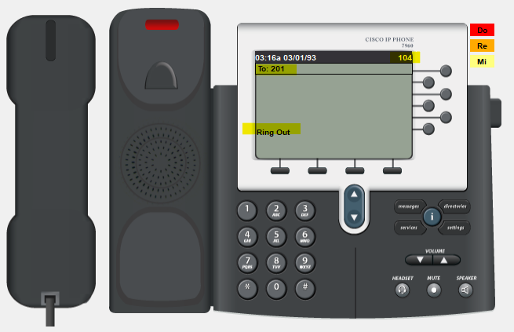
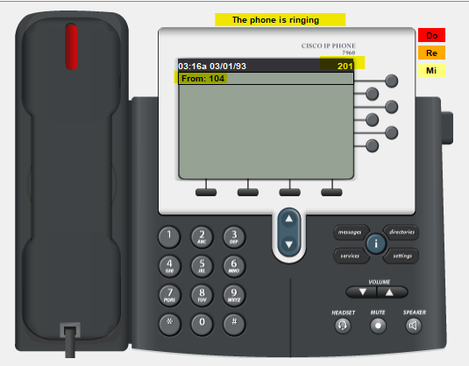
10.Dial peer configuration
Inter-department call facility is enabled via this protocol.
For every department, the dial range is assumed as 1.., 2.., 3.. and 4..

Slide 20
testing
Testing the network….

Slide 21
Testing
Pinging into other departments
Inter-department remote login
Calling (Inter and Intra-department)
DNS

Slide 22
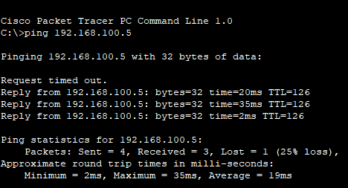
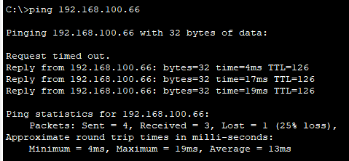
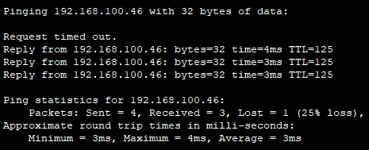
1. Pinging into other departments
From ICT PC
Finance
Sales
HR

Slide 23
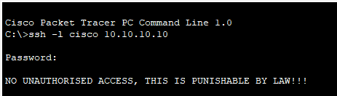
2. Inter-department remote login
As shown, inter-department data access is disabled. (using different VLANs.

Slide 24
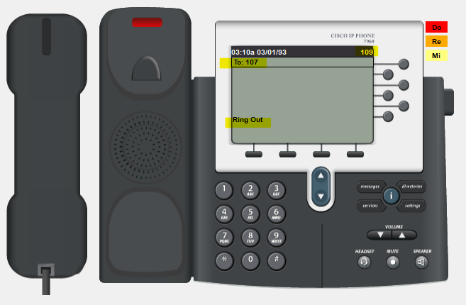
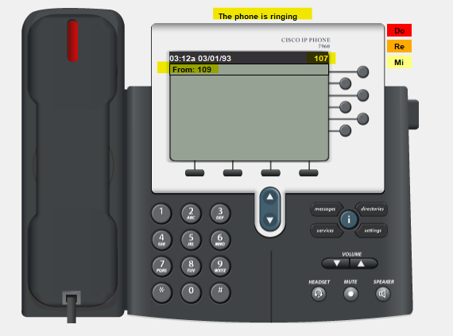
3.1 Calling intra-department
Intra-department call facility is active before step 10 of configuration which is dial-peer configuration.

Slide 25
3.2 Calling inTER-department
As we can see, calling is active between two different departments.

Slide 26
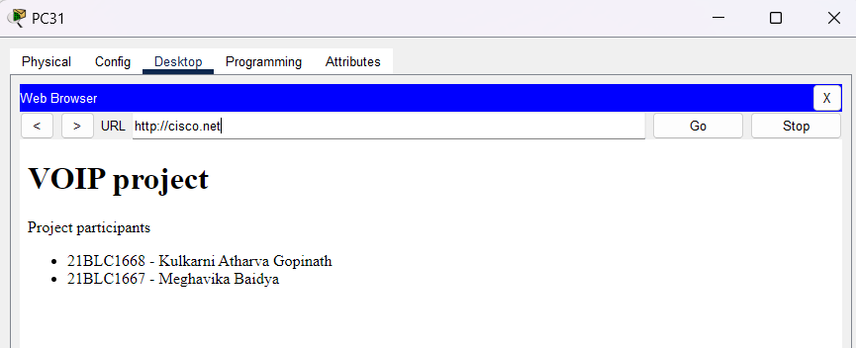
4. DNS
A common DNS server is hosted and is accessible to every PC.

Slide 27
THANK YOU
21BLC1667 – Meghavika Baidya
21BLC1668 – Kulkarni Atharva Gopinath

